Slide 1

PROJECT EXHIBITION I
APPLICATION DEVELOPMENT USING MORDERN DAY LANGUAGES
Guide : DR. VINESH KUMAR
Vellore Institute of Technology, Bhopal
Notes:
sahil

Slide 2
THIS IS OUR TEAM
SAHIL CHAUDHARY
ASHISH SHARMA
ABHINAV KUMAR
APP DEVELOPMENT & DEBUGGER
BHAVYA PATHAK
RESEARCH & BACKEND
RESEARCH &
ANALYSIS
DESIGNER &
Documentation

Slide 3
TABLE OF CONTENTS
01
THE PROJECT
02
OBJECTIVE
03
IMPLEMENTATION
04
FLOW DIAGRAM
05
MODULE SPLIT-UP
06
CONCLUSION
Notes:
ahil

Slide 4


01
THE PROJECT
MANAGEMENT APPLICATION FOR COMMUNITY EASE

Slide 5
WHAT WE ARE WORKING ON
Software for managing various activities in different organisations or housing structures, To reduce the pressure of proper functioning of organisation as it has increased significantly on their respective management committee to keep track of. Hence there is a lot of strain on the person who are running the organisations.

Slide 6

ABOUT THE PROJECT
This particular project deals with the problems on managing a organization and avoids the problems which occur when carried manually. Identification of the drawbacks of the existing system leads to the designing of computerized system that will be compatible to the existing system with the system which is more user friendly and more GUI oriented. We can improve the efficiency of the system, thus overcome the drawbacks of the existing system

Slide 7
HERE IS WHERE WE ARE NOW
NATURE
PAPERWORK
WEB
Less User Friendly
More documentation required (manually)
Only Websites available

Slide 8
WHERE WE WANT TO BE
DIGITALLY
ACCURACY
PRIVACY
NATURE
Everything would be digital
More accuracy provided
More secure environment
MORE USER FRIENDLY

Slide 9
REQUIREMENTS
ANDROID
CONNECTIVITY
RAM
ROM
ANDROID SDK
PERMISSIONS
ANDROID VERSION OF 4 OR ABOVE
STABLE INTERNET CONNECTION
2GB OR ABOVE
2GB OR ABOVE
1GB AND ABOVE
STORAGE & LOCATION

Slide 10
MODULE SPLIT-UP
1. USER :
REGISTER
LOGIN
PROFILE
CALL EMERGENCY AUTHORITIES
ADMINISTRATIVE OFFICE
CLEANING REQUEST
GYM
ORDER FOOD
FOOD CONSENT
DOCTOR
EXPENSE ANALYZER
COMPLAINT
FEEDBACK

Slide 11
MODULE SPLIT-UP
2. STAFF:
LOGIN
PROFILE
CALL EMERGENCY AUTHORITIES
ADMINISTRATIVE OFFICE
UPDATE CLEANING REQUEST
UPDATE GYM REQUEST
ORDER FOOD
VIEW FOOD CONSENT
DOCTOR
COMPLAINT
FEEDBACK

Slide 12
MODULE SPLIT-UP
3. ADMIN:
ABOVE MENTIONED ALL
VIEW STATUS OF REPORTS
SERVER MANAGEMENT

Slide 13
WORKFLOW DIAGRAM
UI/UX-
Flutter
Backend-
Firebase
Android APK
Start
Android Emulator
Local PC
Server
Mobile Devices

Slide 14
SNEAK PEEK

Slide 15


Slide 16

I IANAGEMENT

Slide 17

PPLICATION

Slide 18
FOR

Slide 19

OMMUNITY

Slide 20
ASE

Slide 21
MANAGEMENT APPLICATION FOR
COMMUNITY EASE

Slide 22
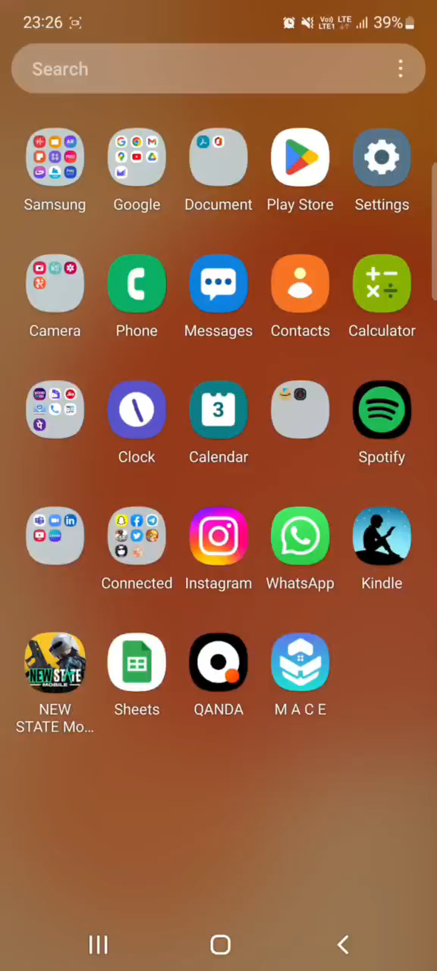
DEMO VIDEO

Slide 23
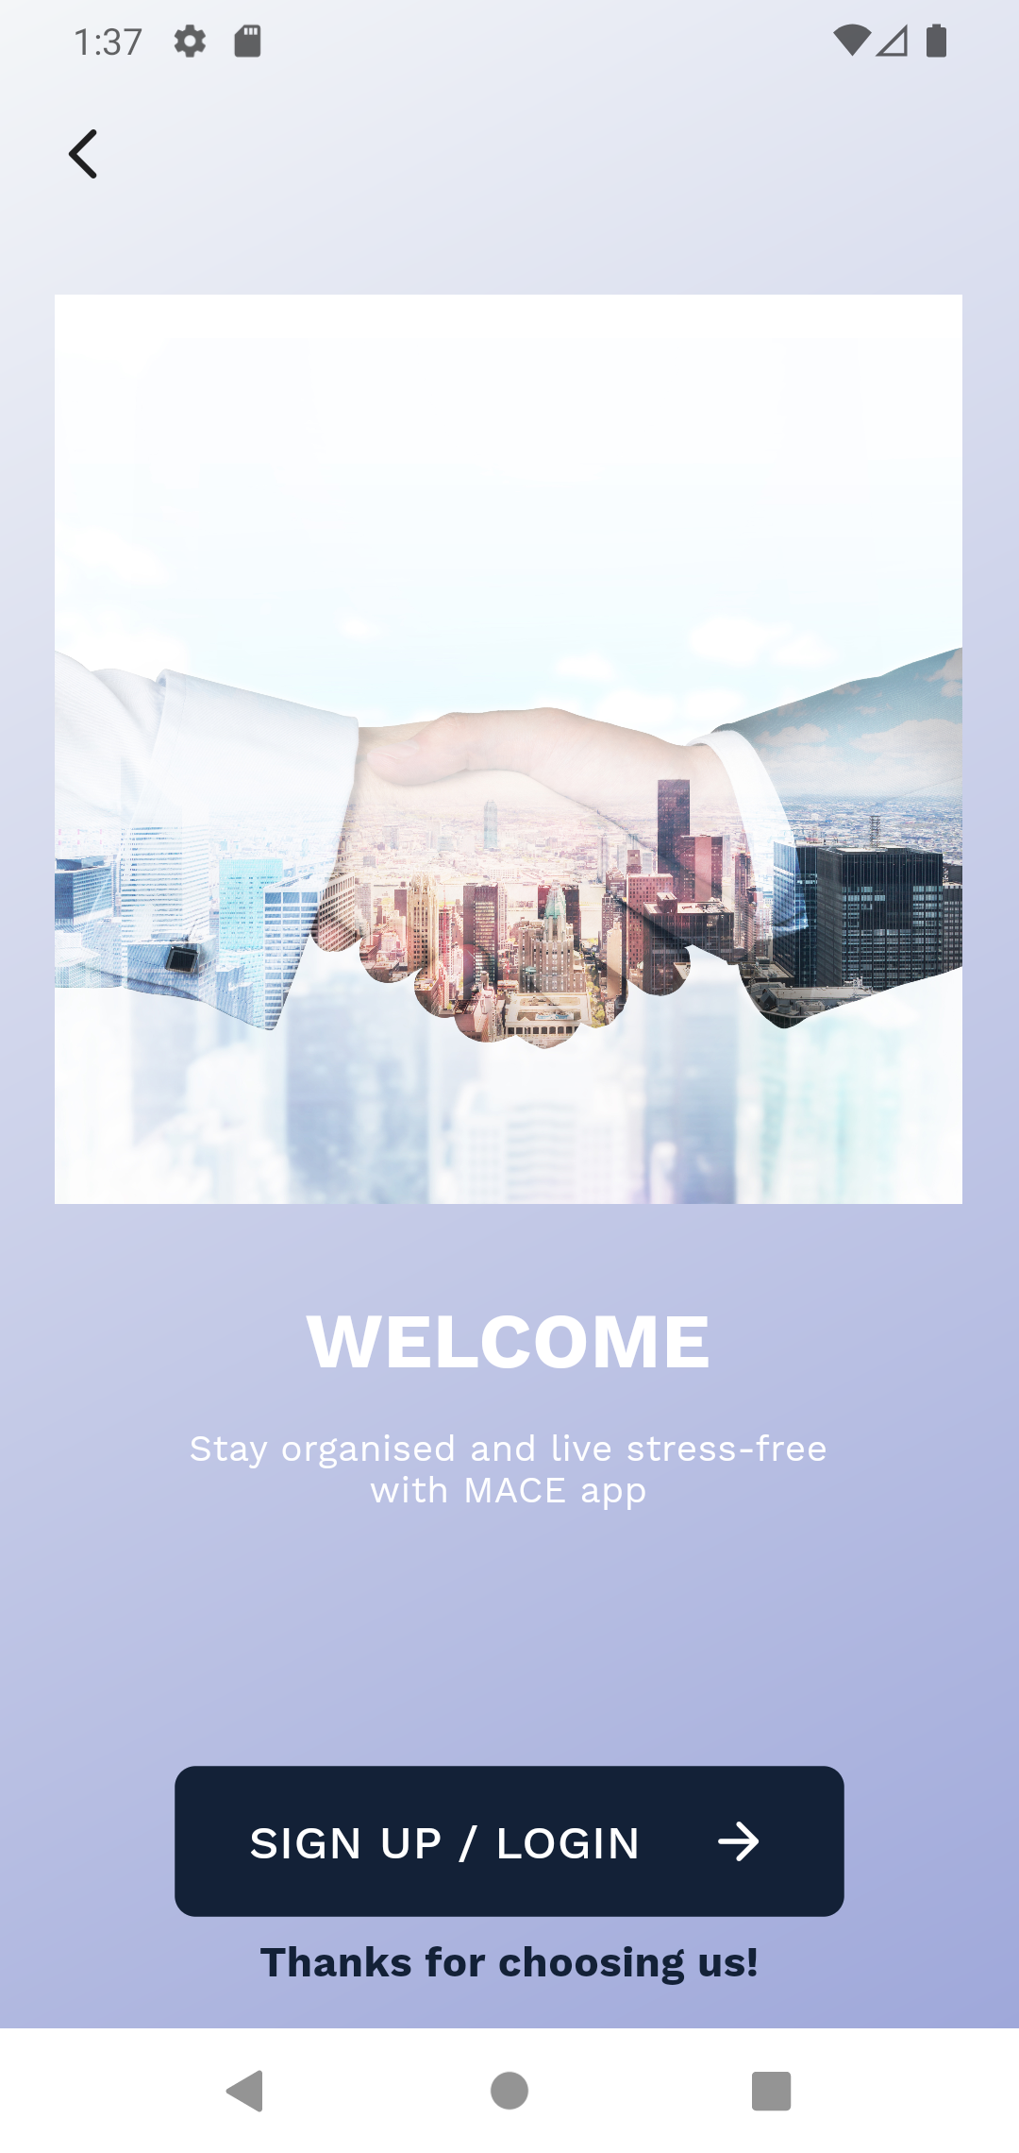
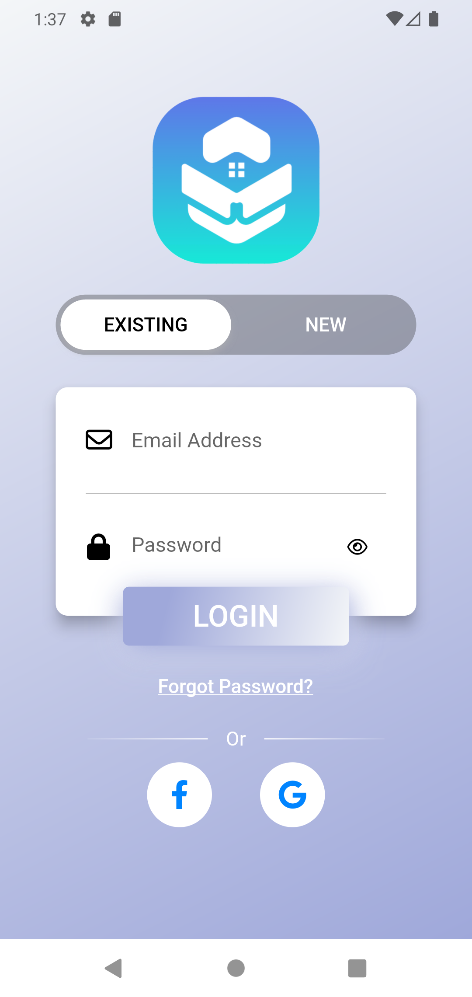
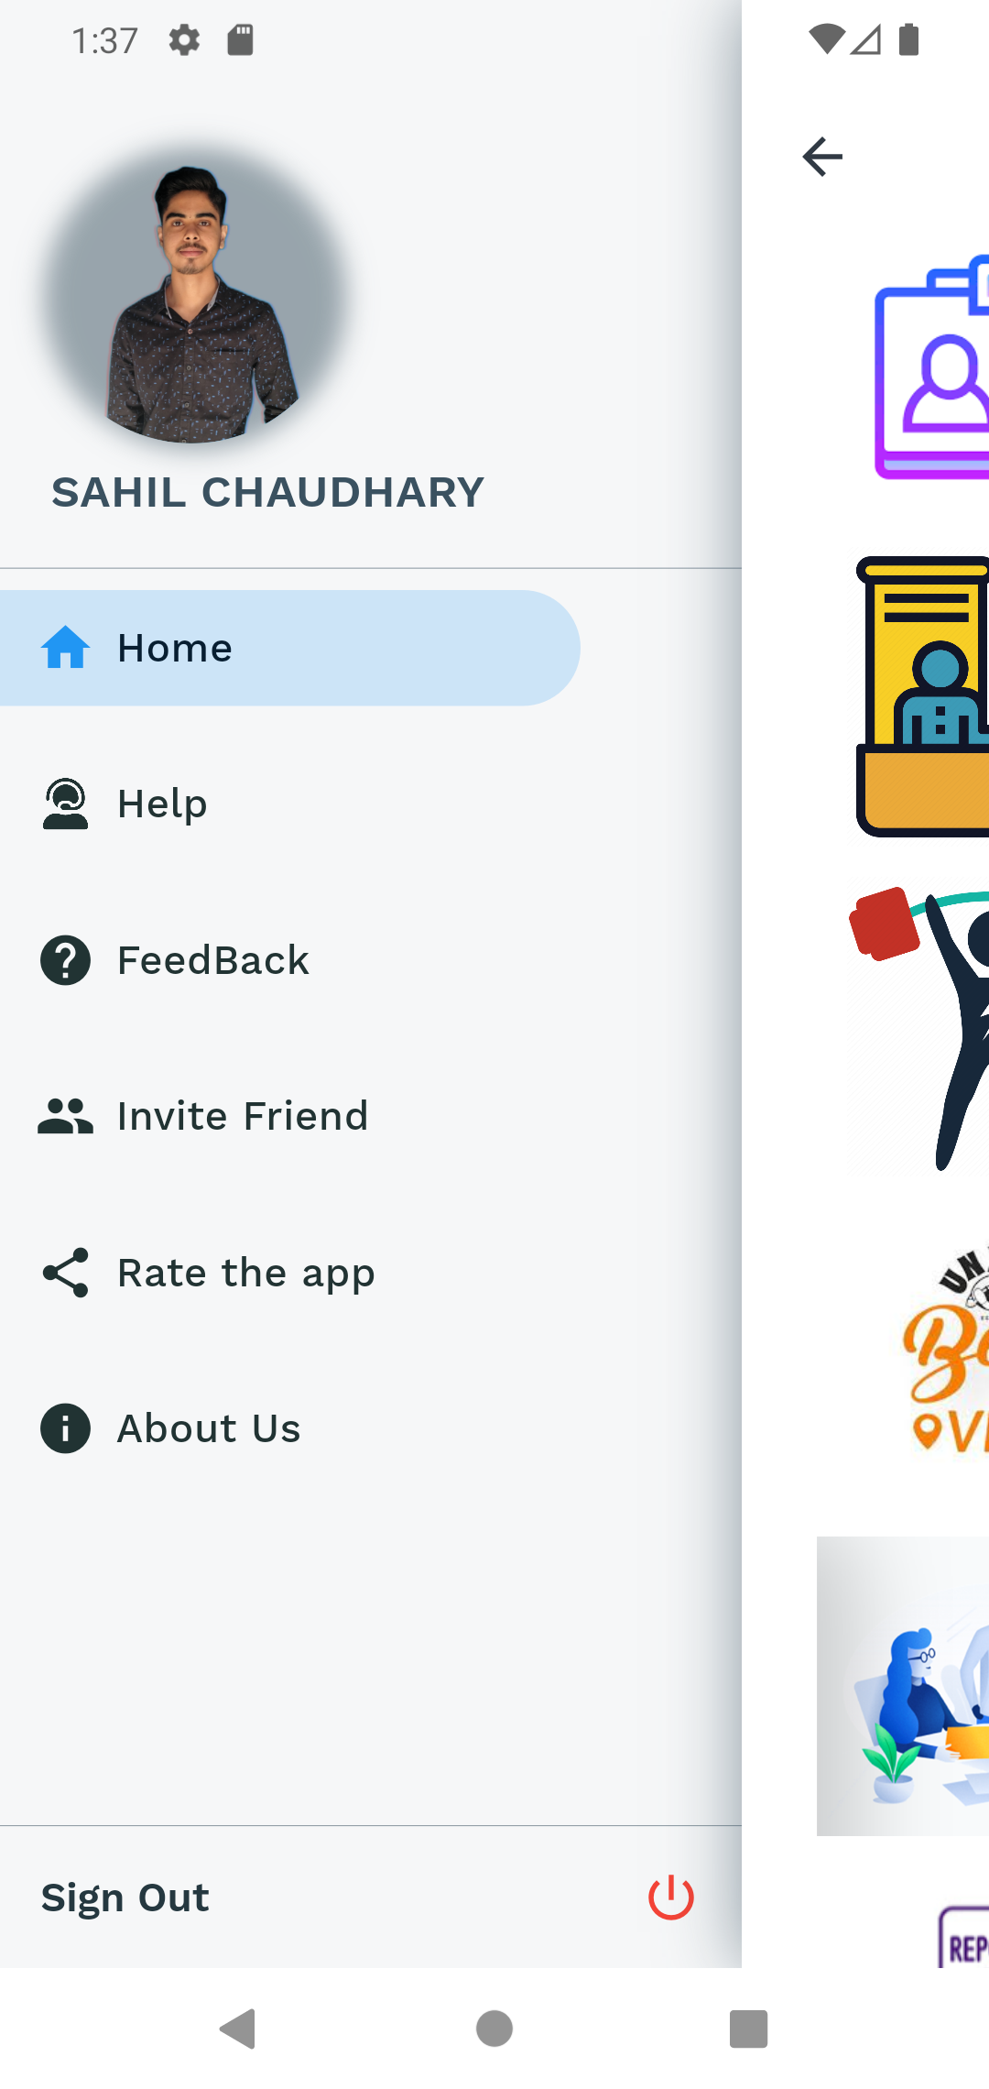

Slide 24
Applications:
01
Hassle free management
Identification of the problems
02
03
Economical to users
Better communication between users and organisations
04

Slide 25
CONCLUSION
MACE is very useful for Organizational and Community management . This Application is designed for people who want to manage various activities in their Organizations.
The goal is to automate its current manual method with the aid of computerized tools and
comprehensive computer software, meeting their needs, so that their important data and information may be saved for a longer period of time with simple access and manipulation

Slide 26
REFERENCES
1. DEV COMMUNITY : https://dev.to/
2. FLUTTER DOCUMENTATIONS: https://docs.flutter.dev/ , https://api.flutter.dev/index.html
3. ANDROID STUDIO DOCUMENTATION: https://developer.android.com/docs
4. ERROR SOLVING: https://www.appsloveworld.com/
5. FIREBASE DOCUMENTATION: https://firebase.google.com/docs
6. THE NET NINJA: https://www.youtube.com/c/TheNetNinja/playlists?app=desktop
7. Various articles available on Google Scholar

